Slide 1
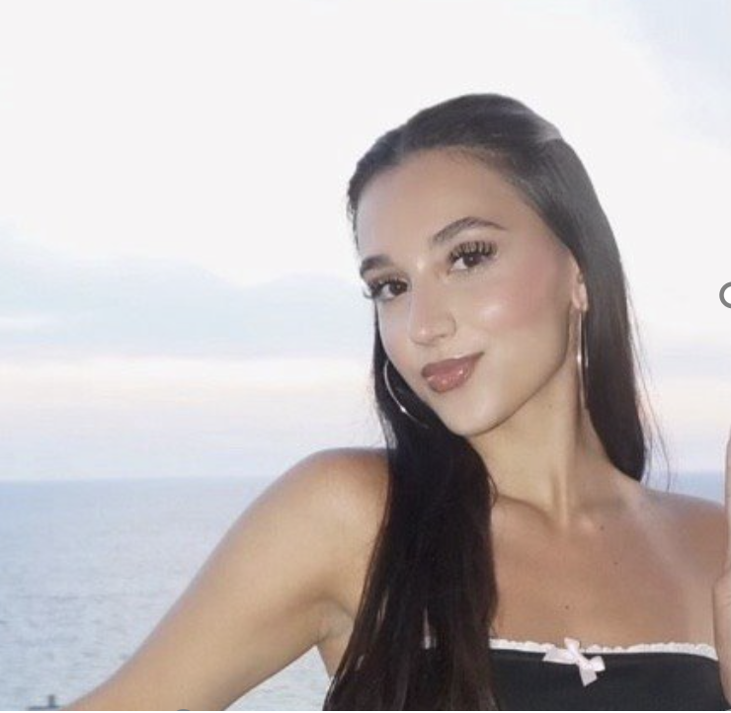
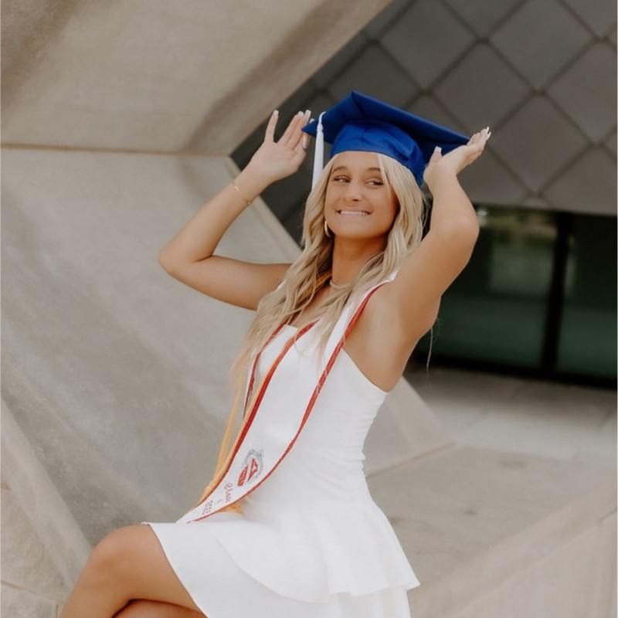
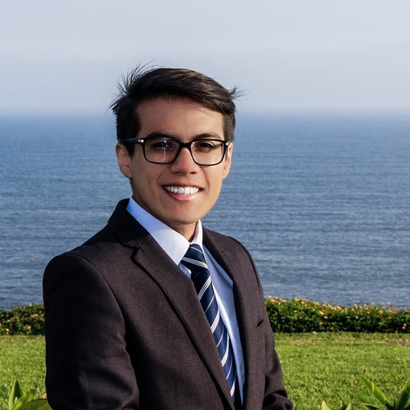
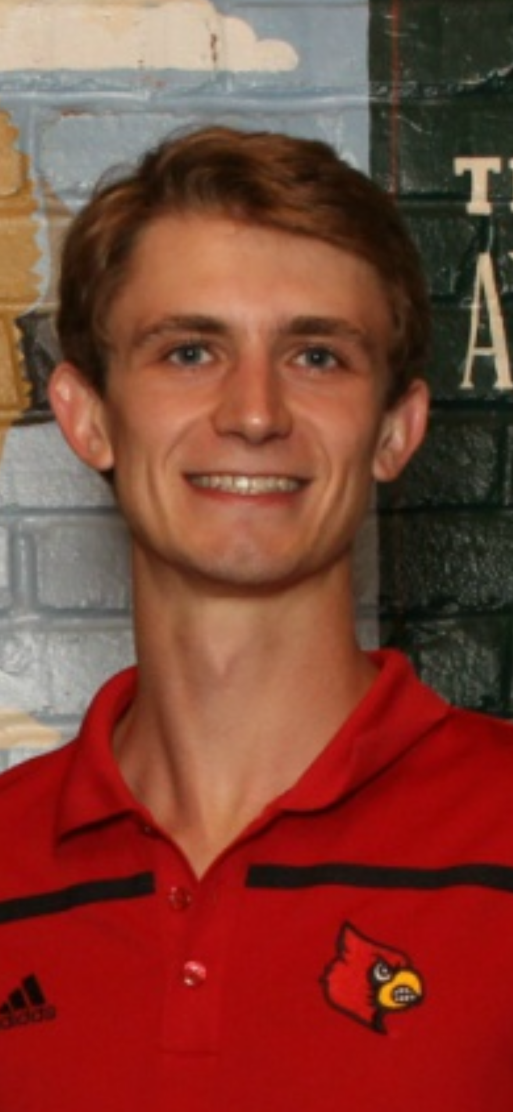
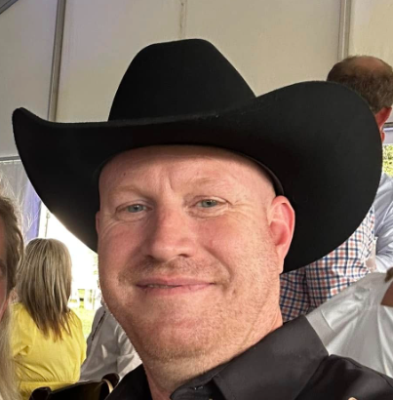
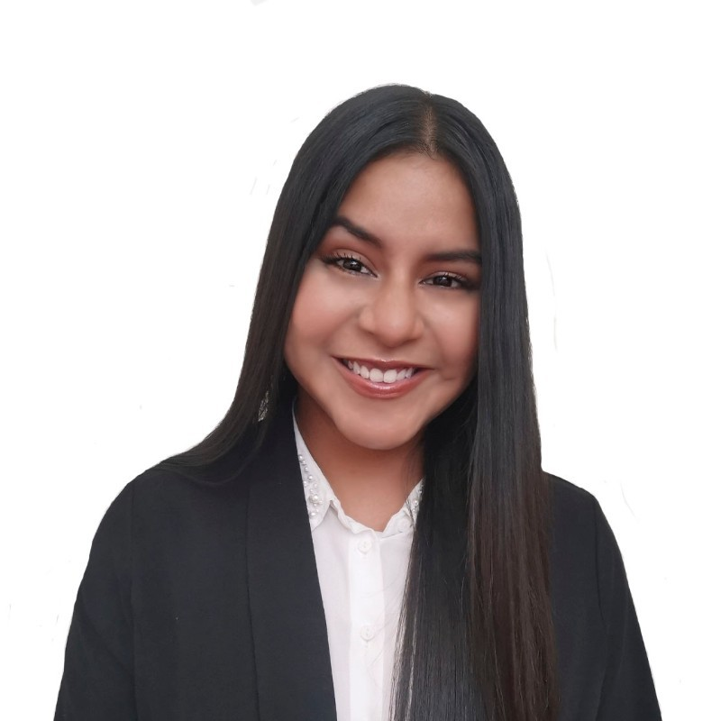
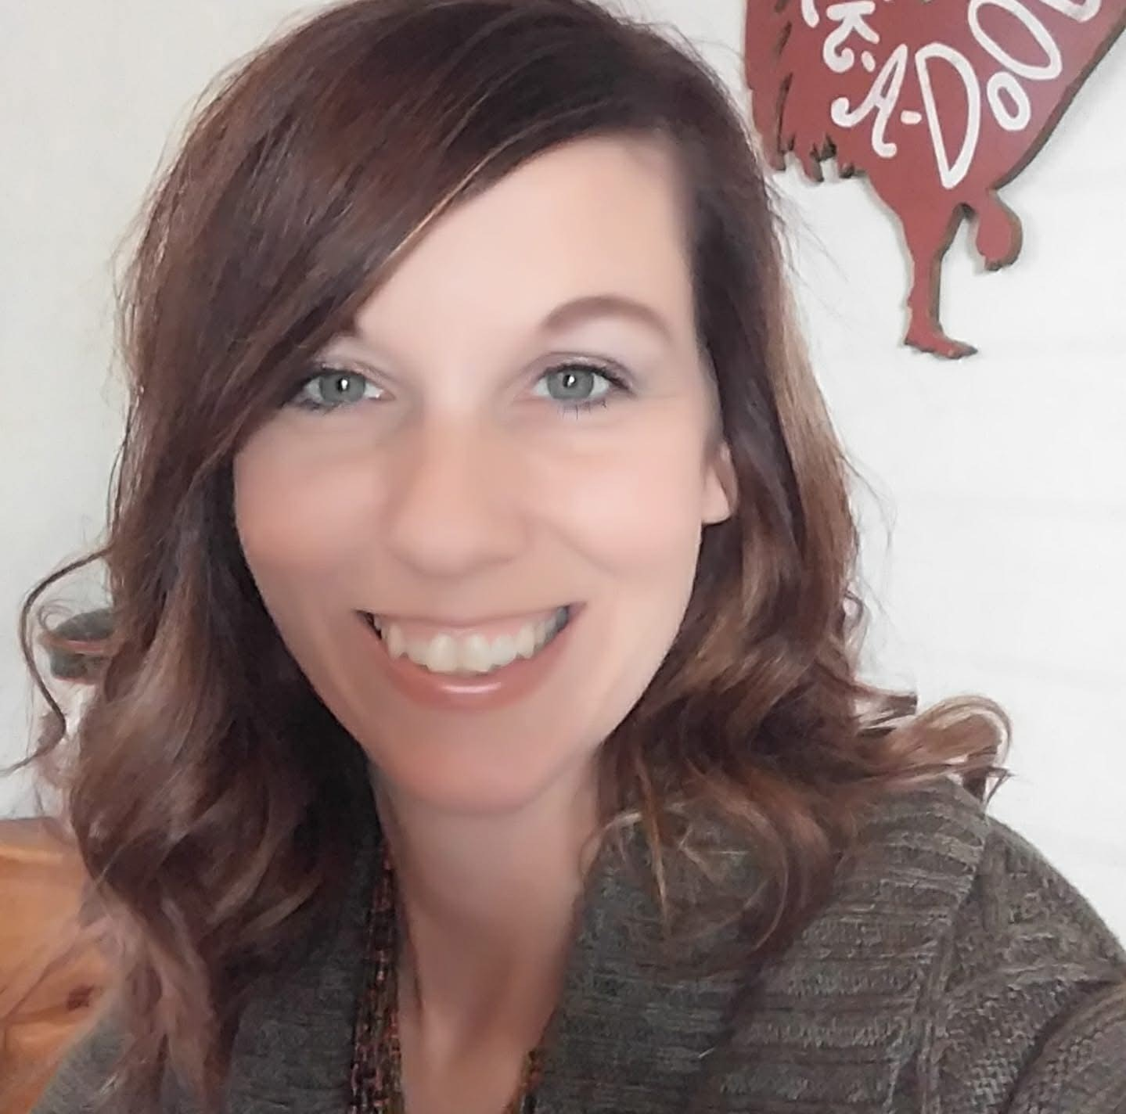
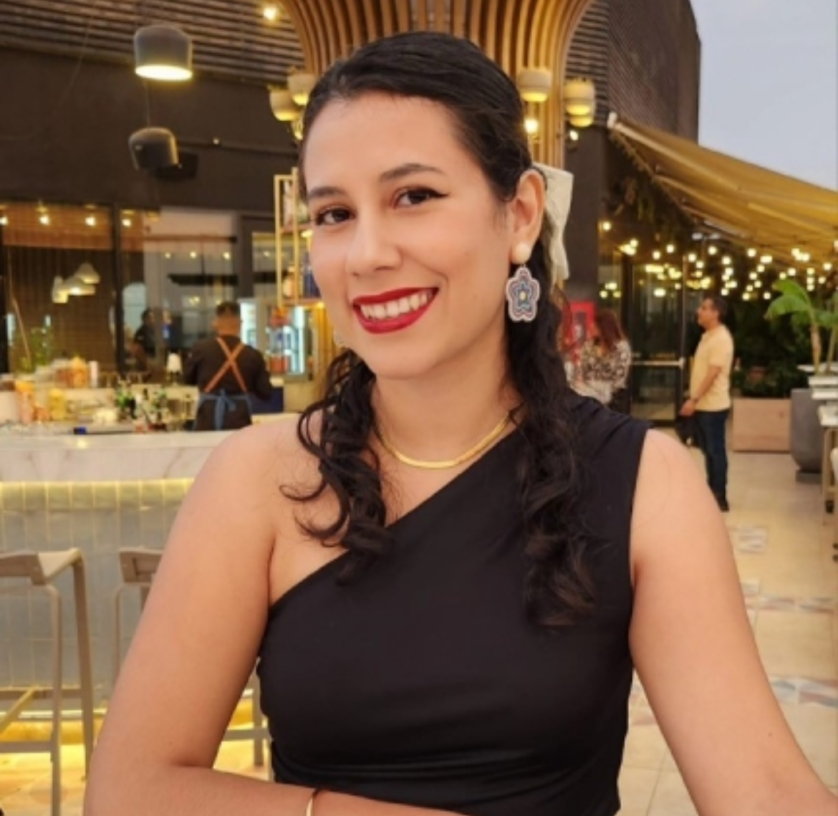
Marketing Org Chart
Renzo
Mogrovejo Growth Engineer (remote)
Ilda Kovacevic Social Media Manager
Marissa Degrella Content and Design Team Lead
Steven Bennet
Business Analytics
Ximena Livia Growth Marketing Coordinator (remote)
Brian Hyatt
VP of marketing, sales & partnerships
Fiorella Martinez
Graphic Design
Crystal Hager Member Care Advocate
Melisa Riggs
Member Care Advocate

Slide 2
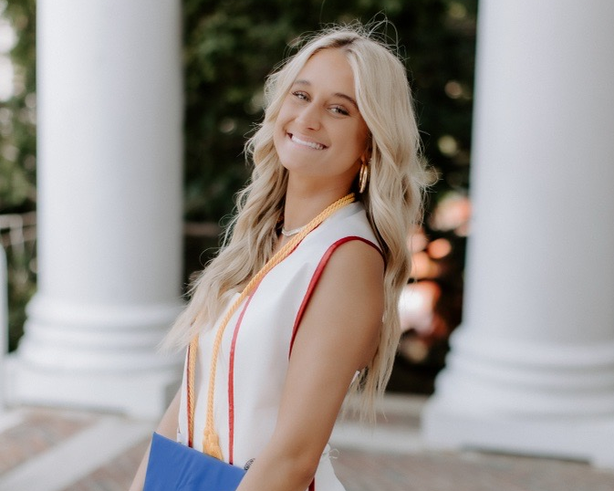
Marissa DeGrella
SAN
Content and Design Team Lead
Function: Keeping the Marketing Team in check
I support, organize and coordinate our marketing agenda focusing on internal marketing acting as the main point of contact to the practice.
Background:
2 years experience in Social Media Management

Slide 3
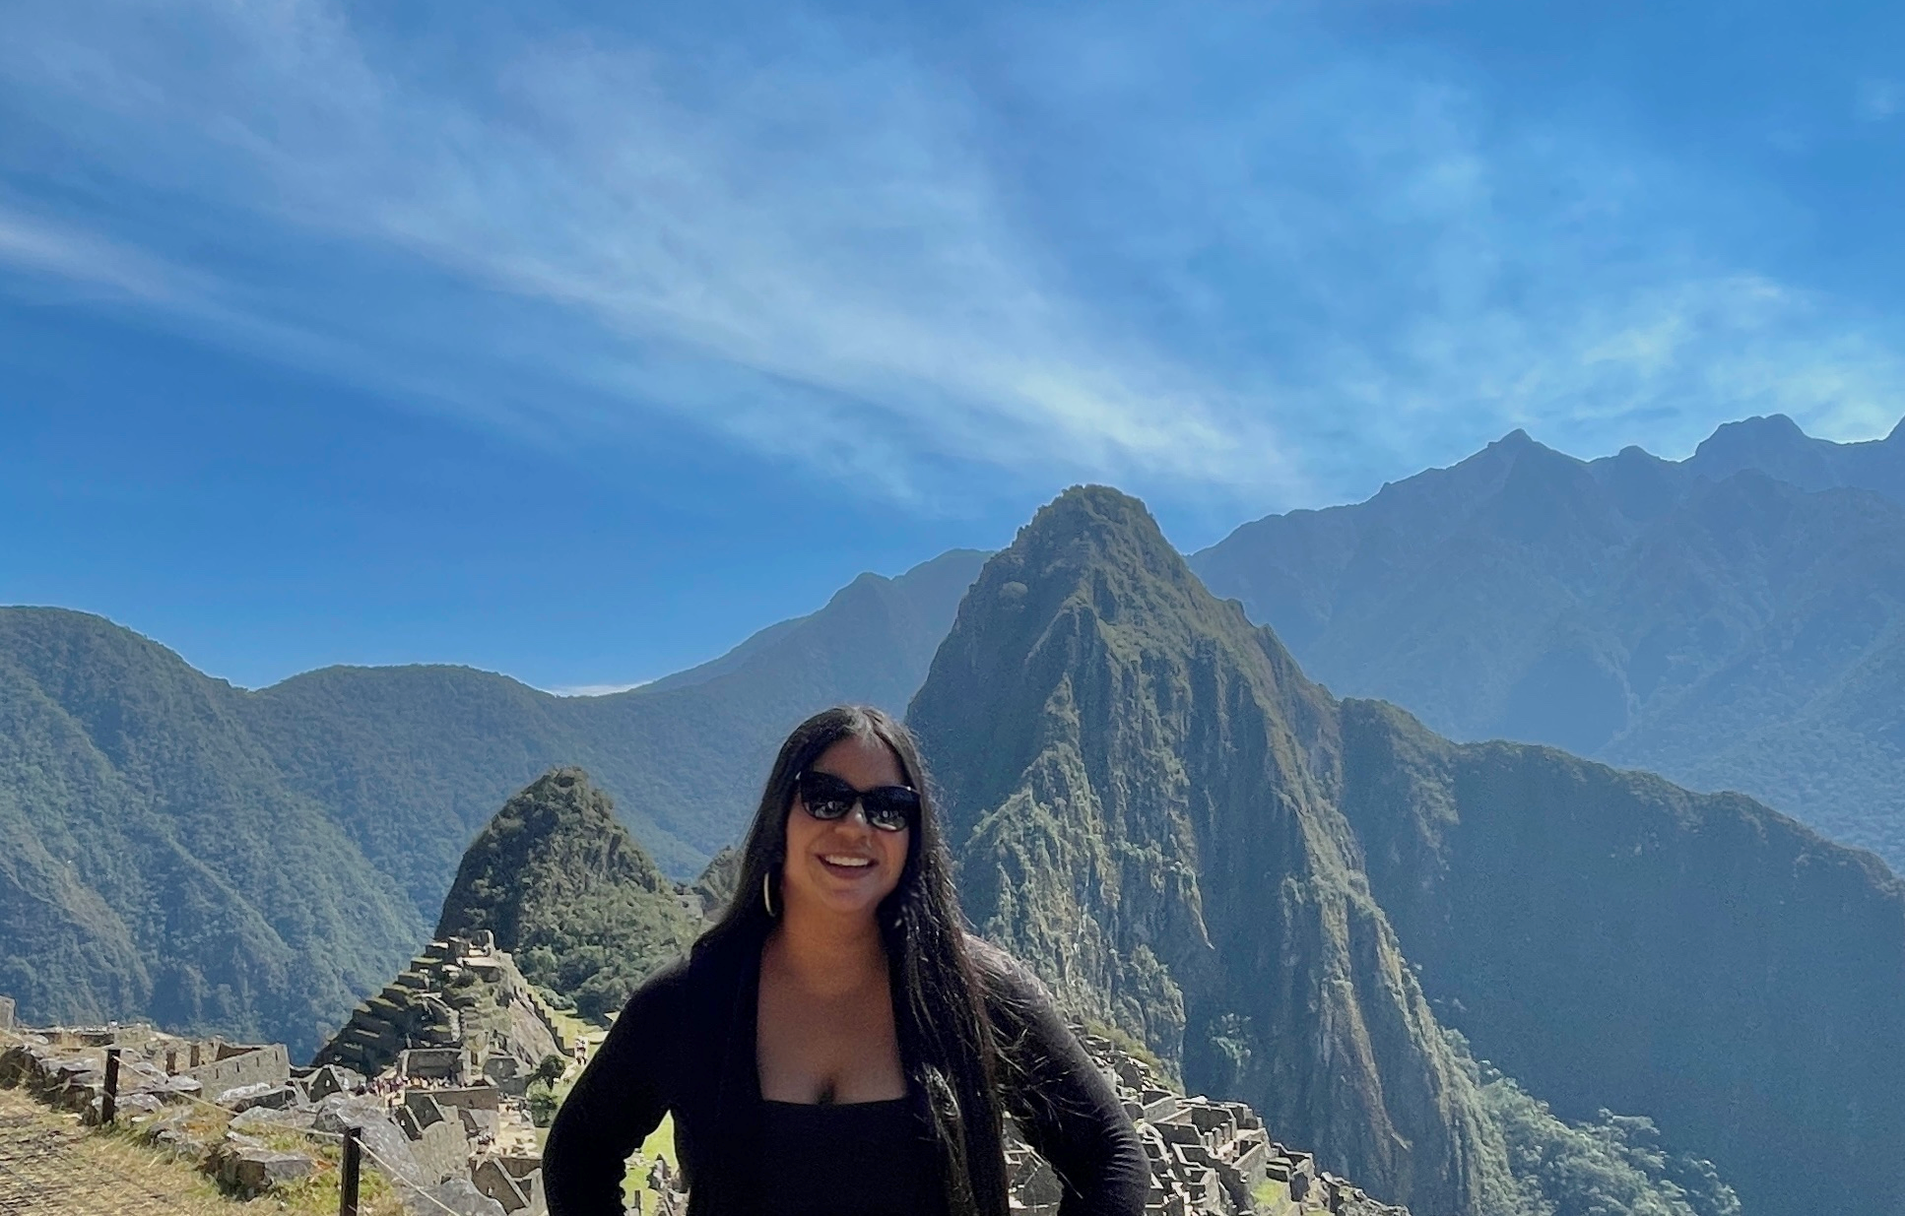
Ximena Livia
SAN
Growth Marketing Coordinator
Function: To spark scalable and sustainable growth
Driving growth by rolling out data-driven strategies and fine-tuning funnels. Focusing on end-to-end marketing efforts to fuel long-term business success.
Background:
Growth Marketer with expertise in driving business growth and optimizing results in fast-paced environments. I leverage data-driven insights to develop and execute growth strategies that helped scale businesses across multiple regions.
Full stack & international marketer (10+ countries).
Growth Team at: Picap App, S4Learning, Cirkula App, Kashio
Experience on B2C/B2B, digital products/platforms, mobile apps, fintech, food-tech, ed-tech, gambling, ecommerce & wellness

Slide 4
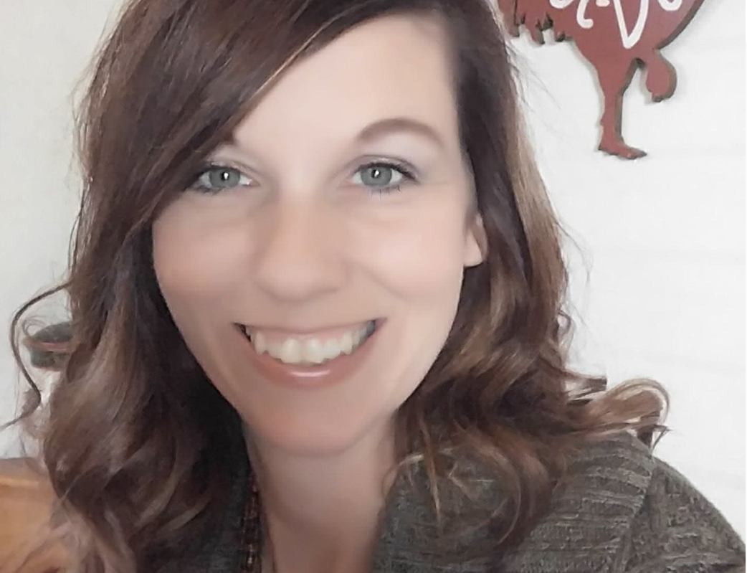
Crystal Hager
SAN
Member Care Advocate
Function: Making sure people are happy, healthy, and get in the doors to become the best version of themselves possible!!
Empowering and educating people of our brand and what our services have to offer. Helping direct people on the correct path for better overall health.
Background: MCA for two years; Over 15 years Client Services in Medical and Healthcare needs; Over four years in Medical Appeals and Approvals for Medicare recipients.
Enjoy Cooking and Baking good yummy meals
Huge pet lover
Love the outdoors! Hiking is one of my favorite hobbies
Keeping up with my kiddos and staying healthy

Slide 5
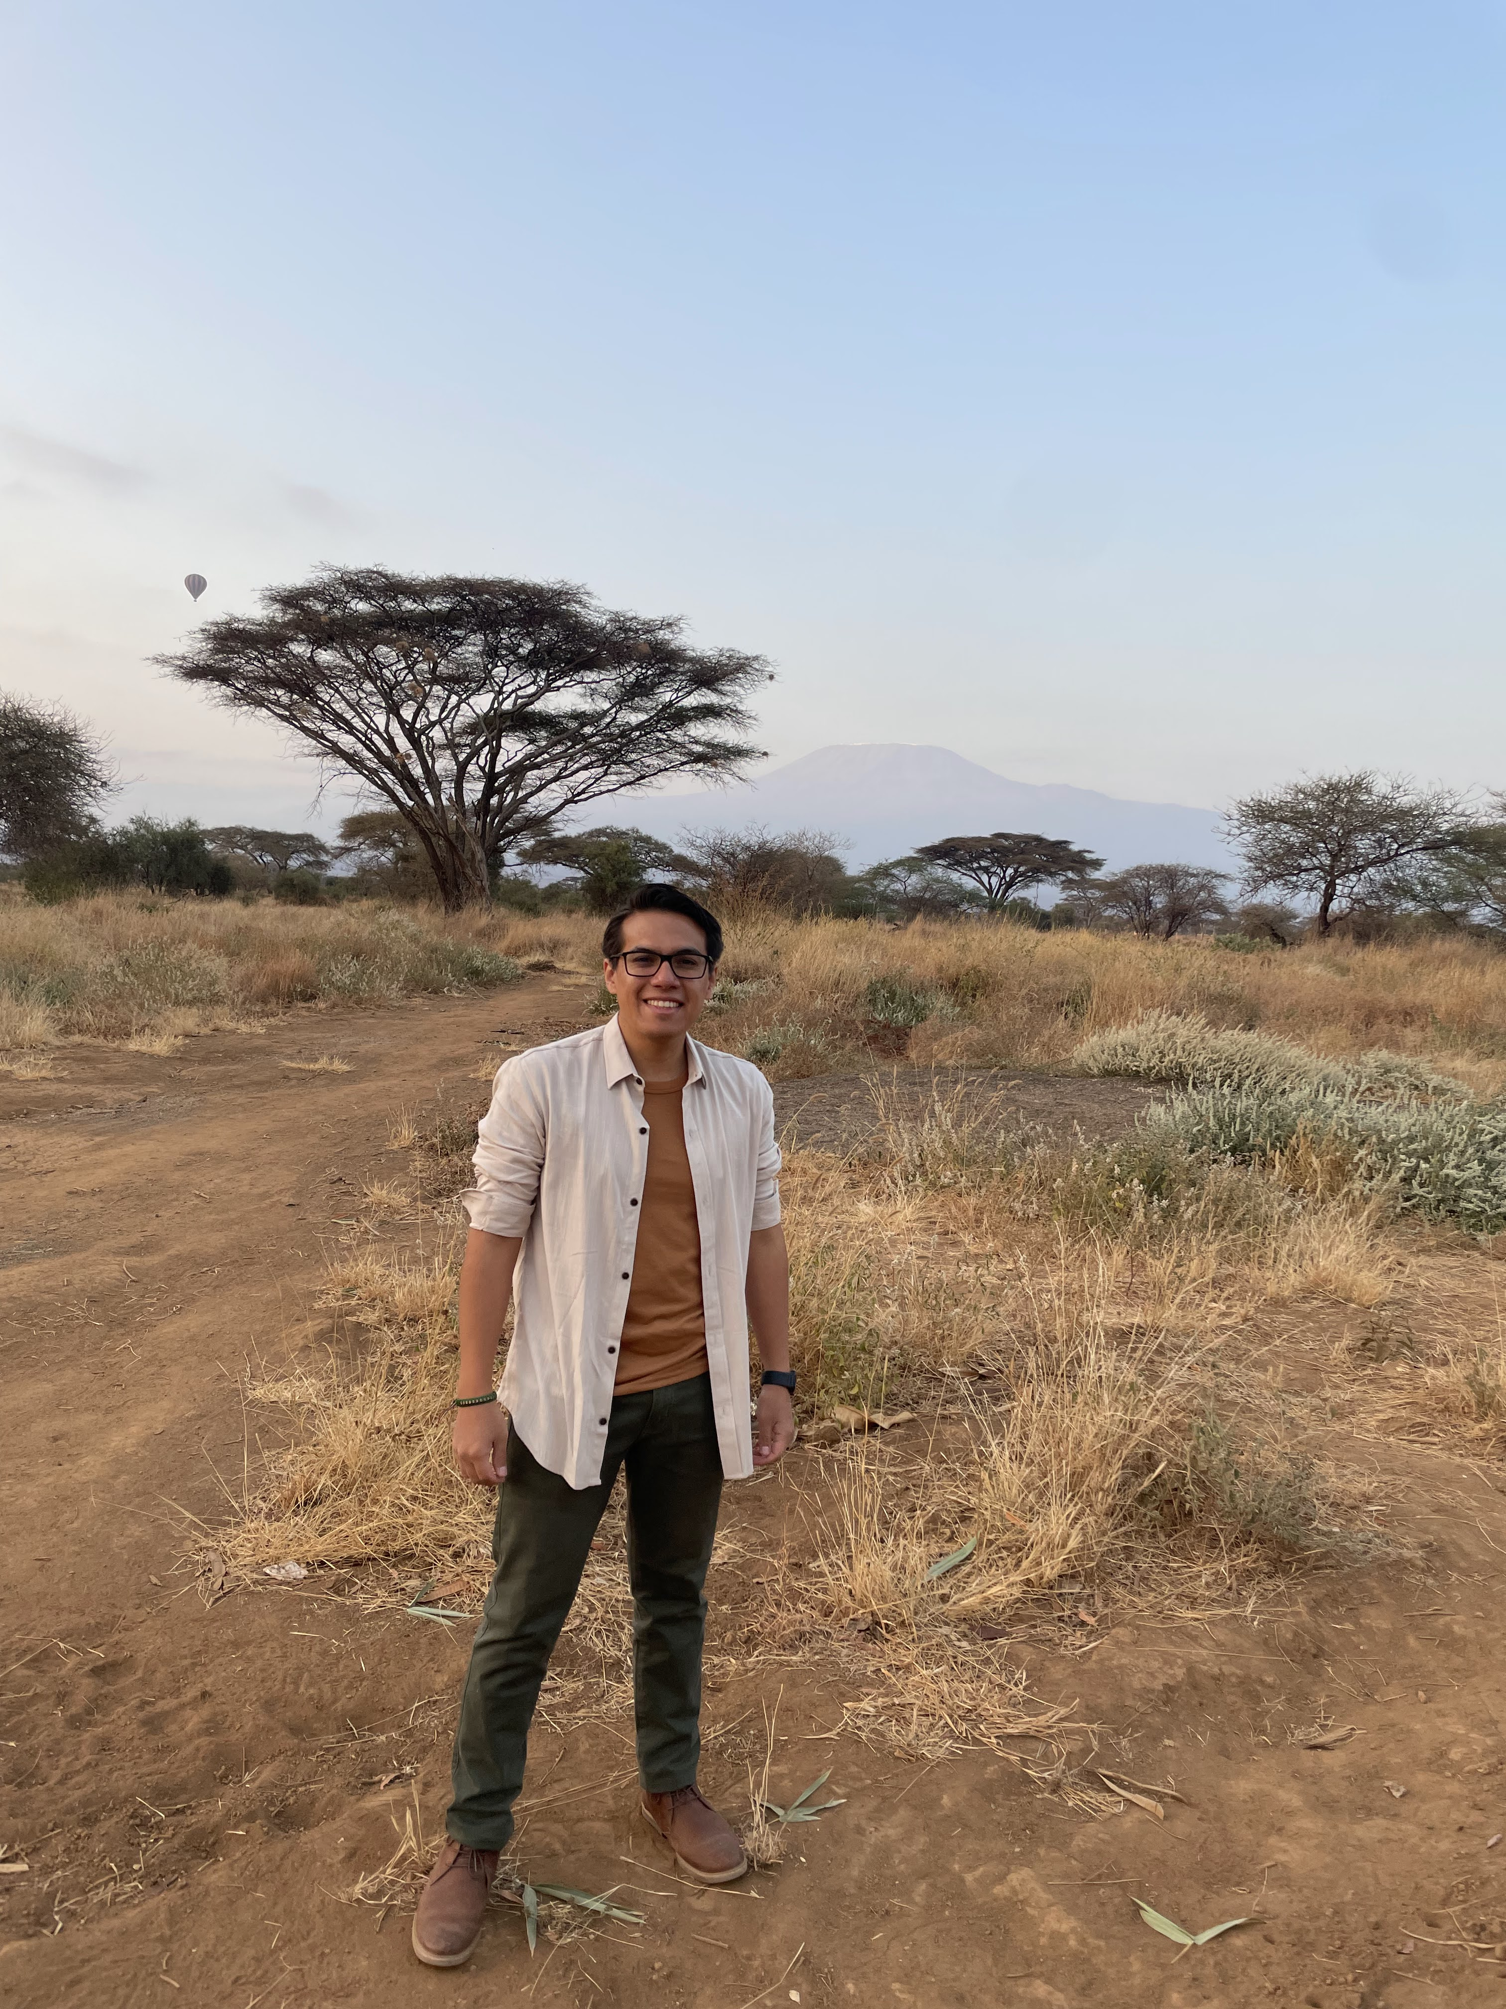
Renzo Mogrovejo
SAN
Growth Engineer
Function: Turning code into growth
I use technical skills and data analysis to drive user acquisition, retention, and revenue. I design experiments, build features, and optimize systems to enhance growth, collaborating with cross-functional teams to deliver impactful, scalable solutions.
Background:
Experienced Product Leader focused on scaling products, driving ARR growth, and improving customer satisfaction.
Product & Tech at Exactera, Riqra, and Fandango (NBCU)
Proficient in leading cross-functional teams, launching impactful features, and managing complex integrations.
Experience in b2c/b2b, road mapping, strategy, OKRs, user & market research, PRD writing, wireframing, agile, and scrum.
Industries: fintech, tax-tech, e-commerce, and entertainment.

Slide 6
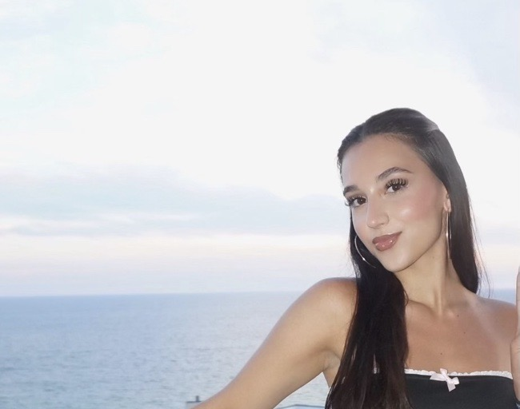
Ilda Kovacevic
SAN
Social Media Manager
Function: Will film videos create, moderate and talk with our current and prospective members/patients in our social media space but make it cute
Background: one year of managing social media platforms

Slide 7
Steven Bennett
SAN
Business Systems Analyst
Function: Number Cruncher
To enhance the quality of data we receive from day-to-day operations, provide quantitative reasoning behind business decisions, and set up systems to increase efficiency within the company
Background:
Computer Engineering at the University of Alabama

Slide 8

Ennu Brand Launch Video

